Slide 1
Data Science Capstone project
<SALAMI, Olatunde Stephen>
<August 10, 2021>

Slide 2

Outline
Executive Summary
Introduction
Methodology
Results
Conclusion
Appendix

Slide 3

Executive Summary
Summary of methodologies:
SpaceX’s Falcon9 rocket launch trip is advertised as 62 million dollars on their website, this is at 3x lesser than there contemporaries. The low pricing from SpaceX is because they can reuse the first stage components, which is often dependent on a successful falcon9 rocket landing.
In this report, I collected, processed, and analysed historic Falcon9 rocket launches, then predicted using Machine Learning approach, the possible outcome in the rocket launch.
Summary of all results:
A successful rocket launch is depended on many factors such as payload mass, orbit type, launch sites, etc.
Advancement in the technology is aiding improved research, thus contributing to closing the knowledge gap, thereby improving the success rate year on year.

Slide 4

Introduction
Project background and context
Falcon9 is part of the falcon rocket family. It is designed and operated by private manufacturer SpaceX. They are mainly used for space exploration such as; cargo delivery, crewed flights to the International Space Station (ISS), etc. (Wikipedia).
Since June 2010, rockets from the falcon9 family have been launched 126 times, with 124 full mission successes, one partial failure and one total loss of spacecraft (Wikipedia), hence they have a good record of launches.
The landing performed on Falcon9 after there launches is usually controlled, hence there high success landing rate. This allows for of reusability, and thus low fare pricing compared to there competitors.

Slide 5
Introduction
Objectives
For other manufacturers to stand a chance against SpaceX, historical falcon9 launch data needs analyzed for key questions such as:
What are the principal factors for a successful landing?
What factors are associated with failure landing?
If known, Information on a possible successful rocket landing can be used by other rocket companies to bid against SpaceX’s rocket launch pricing.

Slide 6

Methodology
Data collection methodology:
Describes how data were collected
Performed data wrangling
Describes how data were processed
Performed exploratory data analysis (EDA) using visualization and SQL
Performed interactive visual analytics using Folium and Plotly Dash
Performed predictive analysis using classification models
Built, tune, and evaluated classification models

Slide 7
Methodology

Slide 8
Data collection
How the datasets were collected?
Data used for this analysis was collected using two different approaches:
Through REST API request made directly to the SpaceX API
Web scraping the Wikipedia page for relevant Falcon9 historical launch table
Here’s a Github link to the complete notebook of the data collection

Slide 9
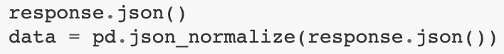
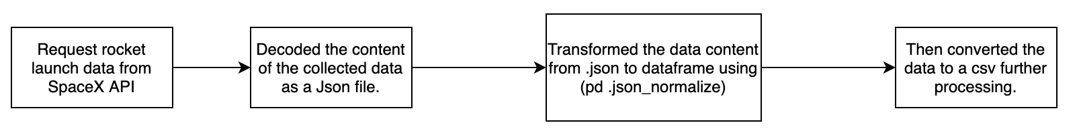
Data collection – REST API
Initiated a request to SpaceX API
Then converted the response content into a pandas dataframe for Cleaning, and further processes
Below is a flowchart of the collected process.
Here’s a Github link to the complete notebook of the data collection

Slide 10
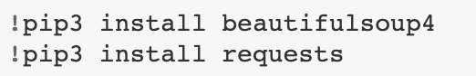
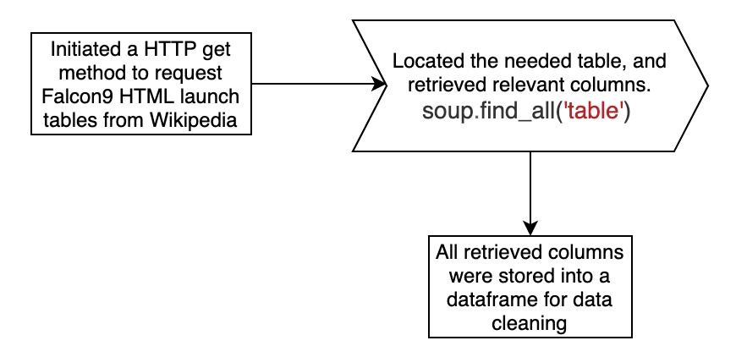
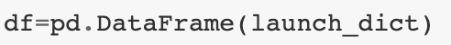
Data collection – Web scraping
The webscraping was done using BeautifulSoup (a python package)
Extracted a falcon9 launch record HTML table from Wikipedia
Parsed the table and converted it to a dataframe.
A flowchart of the web scraping process.
Here’s a Github link to the complete notebook for the webscraping

Slide 11
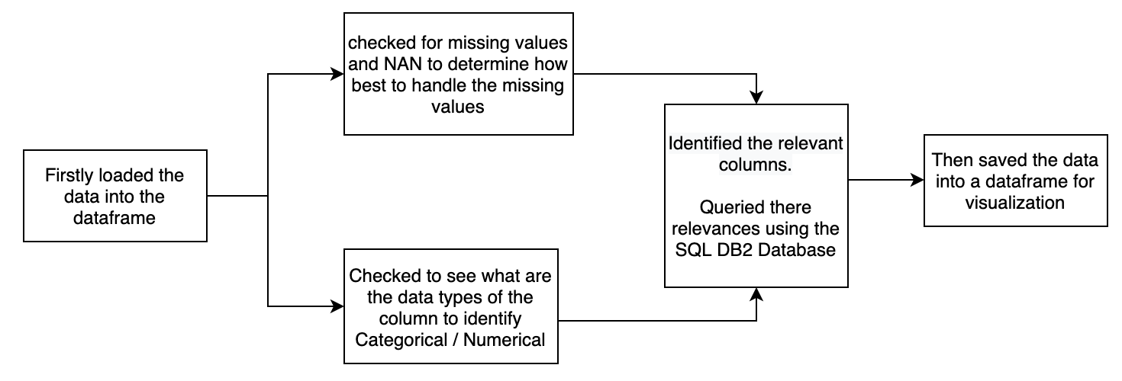
Data wrangling
The objective of the data wrangling is to:-
* Understand the dataset * Data cleaning, and identifying patterns in the dataset
* Determine the labels for training the machine learning model.
Here’s a flowchart of the processes
Here’s a Github link to the complete notebook for the data wrangling

Slide 12
EDA with SQL
SQL queries were further performed to inquire more about the data and establish more validity of the featured columns
Displayed the number of unique lunch sites on the space mission
Displayed the number of unique lunch sites on the space mission
Queried the average payload mass carried by Booster version F9 V1.1
Queried for the first successful landing outcome of the falcon9 rocket
Also queried for the total number of successful outcomes from past Falcon9 rocket landings
Here’s a Github link to the complete notebook for the sql queries

Slide 13
EDA with data visualization
Some graphs were plots to establish a relationship between featured columns from the spaceX data based on some domain knowledge and to realise how relevant this relationships are to the outcome of the launches
Scatter Graphs
Flight Number VS. Payload Mass
Flight Number VS. Launch Site
Payload VS. Launch Site
Orbit VS. Flight Number
Payload VS. Orbit Type
Orbit VS. Payload Mass
Bar Graph
Mean Success Rate Vs. Orbit
Line Graph
Mean Success Rate Vs. Year
Here’s a Github link to the complete notebook for the data visualization exercise

Slide 14
Build an interactive map with Folium
Collected the coordinate of each launch site, and added folium.Circle and folium.Marker for each launch site on the site map, to visualize the relative positions of the key locations
Created a new column in launch sites dataframe called marker colour to store the marker colours based on the class value (successful/failed rocket landing).
Drew a PolyLine between launch sites and some neighbouring facilities to check for there proximities to public paces.
Some of the questions that were answered in this task includes:
Are launch sites in close proximity to railways? Yes
Are launch sites in close proximity to coastline? Yes
Do launch sites keep certain distance away from cities? Yes
Here’s a Github link to the complete notebook for these tasks.

Slide 15
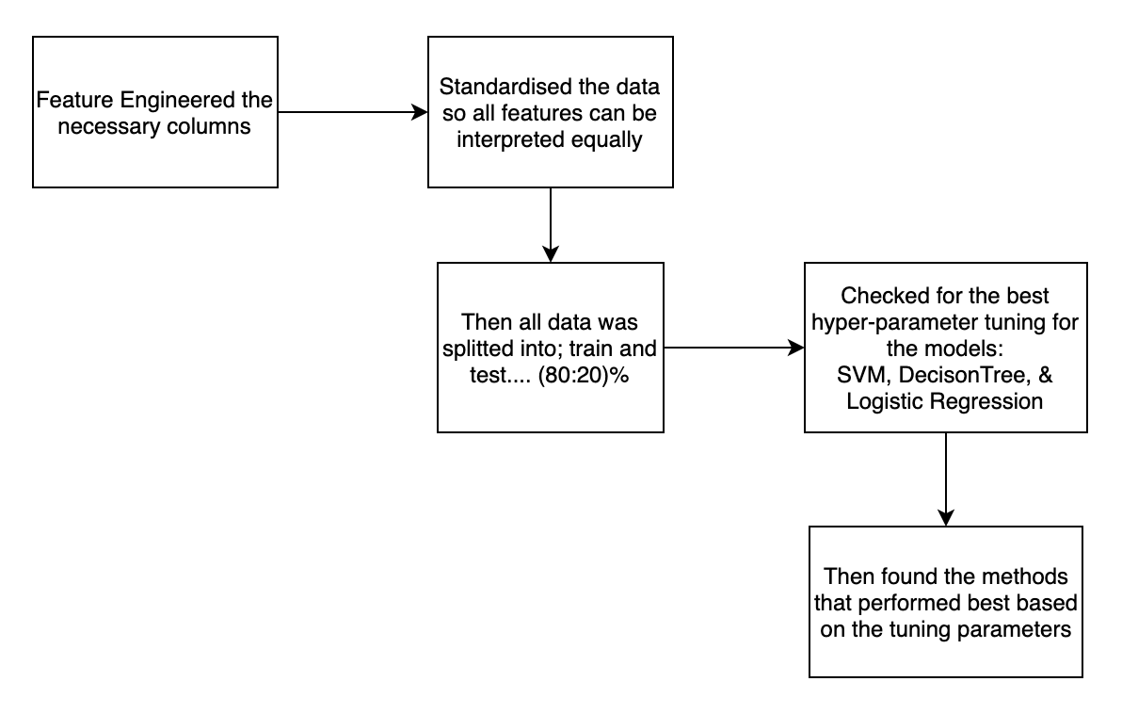
Predictive analysis (Classification)
A machine learning pipeline to predict the outcome of the first stage landing given the data from the preceding labs.
If we can determine if the first stage will land, we can determine the cost of a launch.
Here’s a Github link to the complete notebook for the model prediction.

Slide 16
Results
Exploratory data analysis results
Interactive analytics demo in screenshots
Predictive analysis results

Slide 17
EDA with Visualization
Here’s a Github link to the complete notebook for the visualizations.

Slide 18
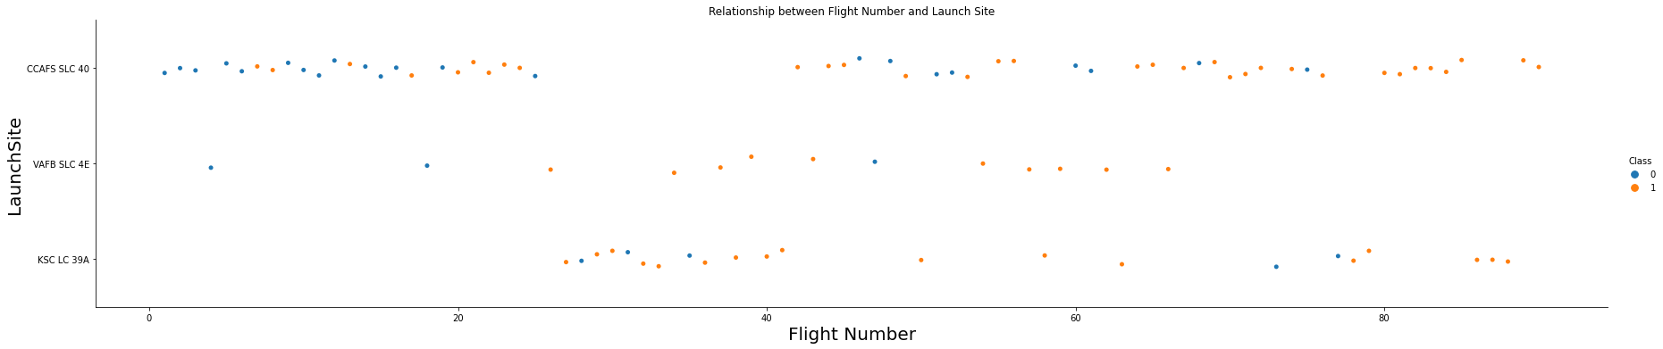
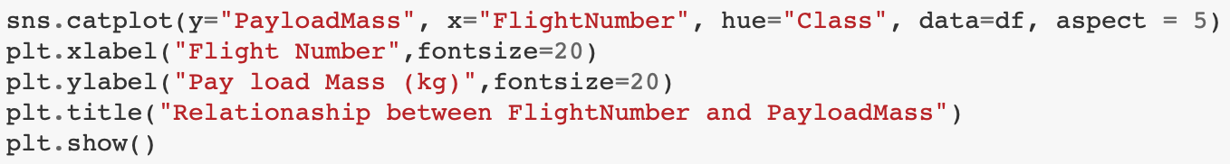
Flight Number vs. Launch Site
From the plot above, we can deduce that :
majority of the flights took place at the CCAFS SLC40 launch site.
That a huge number of flights from the VAFB SLC4E launch site were successful.

Slide 19
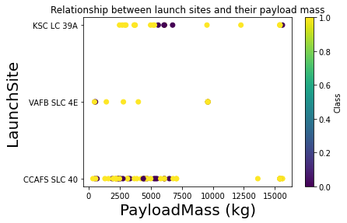
Payload vs. Launch Site
From the plot, we can deduce that :
Flight from VAFB SLC4E: Have a max payload of 10,000kg, and mostly successful.
Most of the flights from the CCAFS SLC40 & KSC LC39A are concentrated within 0-7,500kg payload mass range.

Slide 20
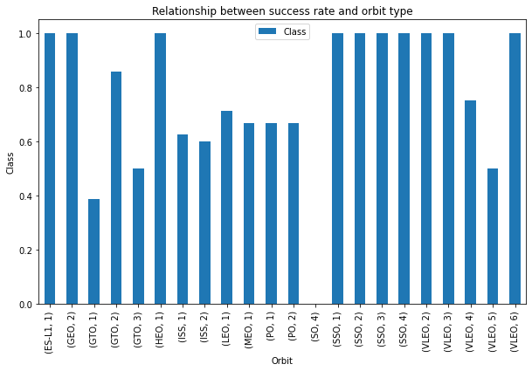
Success rate vs. Orbit type
From the plot, we can deduce that :
Orbits with high success rate includes: ESL, GEO, HEO, SSO, & VLEO
Also, one of the orbits with the lowest success rate is GTO. Others includes: GTO, ISS, & PO.

Slide 21
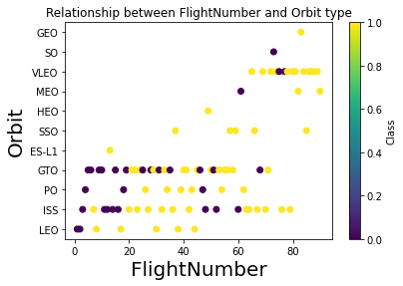
Flight Number vs. Orbit type
From the plot, we can deduce that :
Success rate at LEO improved with increased number of flights;
on the other hand, there seems to be no relationship between flight number when in GTO orbit.

Slide 22
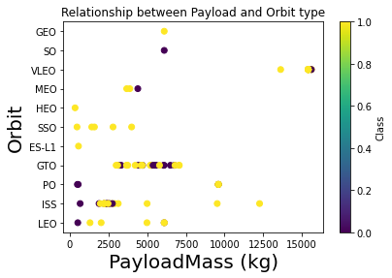
Payload vs. Orbit type
From the plot, we can observe that :
Lower payloads had Successful outcome at the SSO orbit.
LEO, ISS orbits records more success with increasing payloads

Slide 23
Launch success yearly trend
This plot shows a line chart of yearly average success rate
The success rate was unchanged between 2010 -2013.
There period between 2013 – 2017 experienced good success rate
There was a sharp decline in 2018, but was immediately overturned by an improved 2019-2020 outlook

Slide 24
EDA with SQL
Here’s a Github link to the complete notebook for the EDA with SQL.

Slide 25
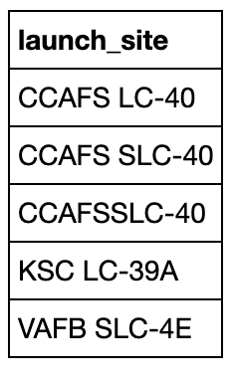
All launch site names
Find the names of the unique launch sites
Query result with a short explanation here
The above query return with 5 unique launch sites from the SpaceX Dataset

Slide 26
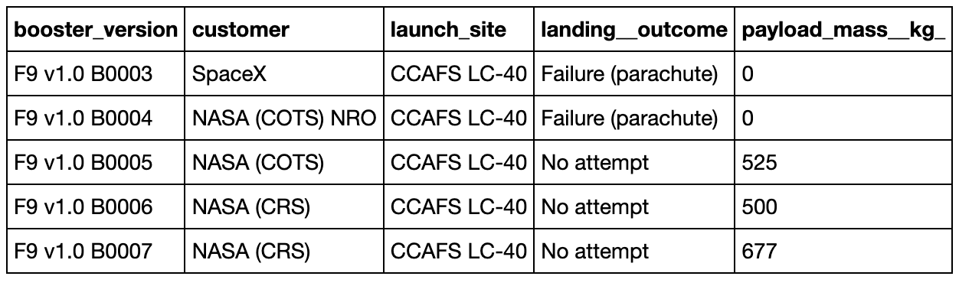
Launch site names begin with `CCA`
Querying for the launch sites beginning with `CCA`
Query result with a short explanation here

Slide 27
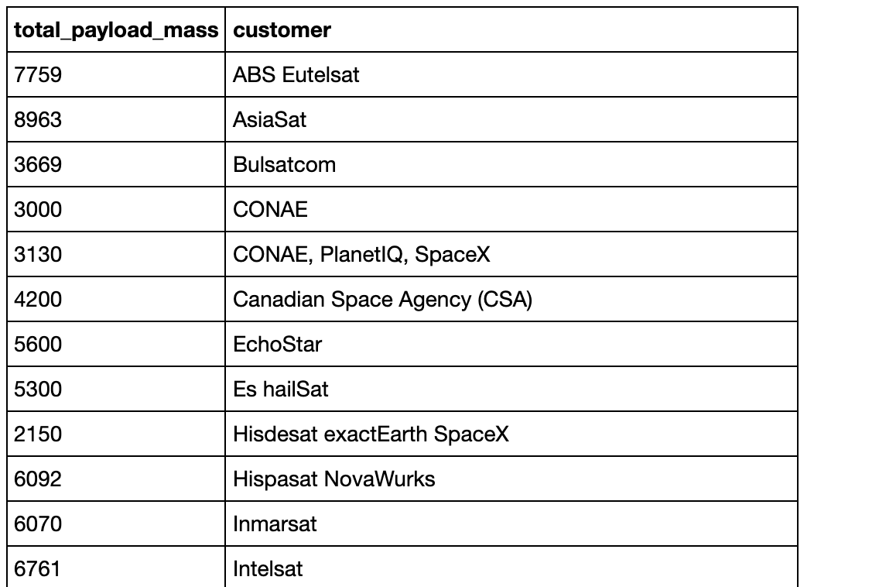
Total payload mass
Calculate the total payload carried by boosters from NASA
Present your query result with a short explanation here
The above query displays the total payload mass carried by boosters launched by NASA (CRS)

Slide 28
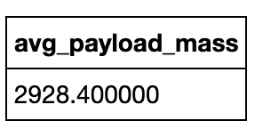
Average payload mass by F9 v1.1
Calculate the average payload mass carried by booster version F9 v1.1
Present your query result with a short explanation here
The above query displays average payload mass carried by booster version F9 v1.1, with an output of 2928,4kg

Slide 29
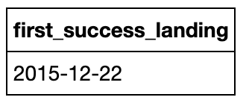
First successful ground landing date
Find the date when the first successful landing outcome in ground pad
Present your query result with a short explanation here
The above query the date when the first successful landing outcome in ground pad was achieved. (12-22-2015)

Slide 30
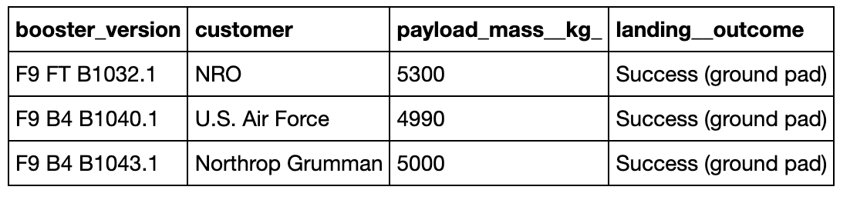
Successful drone ship landing with payload between 4000 and 6000
List the names of boosters which have success in drone ship and have payload mass greater than 4000 but less than 6000
Present your query result with a short explanation here
The output of the above query shows that there are 3 booster versions within this category.

Slide 31
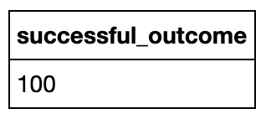
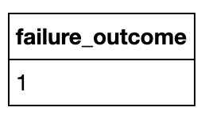
Total number of successful and failure mission outcomes
Calculate the total number of successful and failure mission outcomes
Present your query result with a short explanation here
The above query checks for the number of successful and failed missions, which returns with an output for 100 success missions and 1 failed mission from the spaceX dataset.

Slide 32
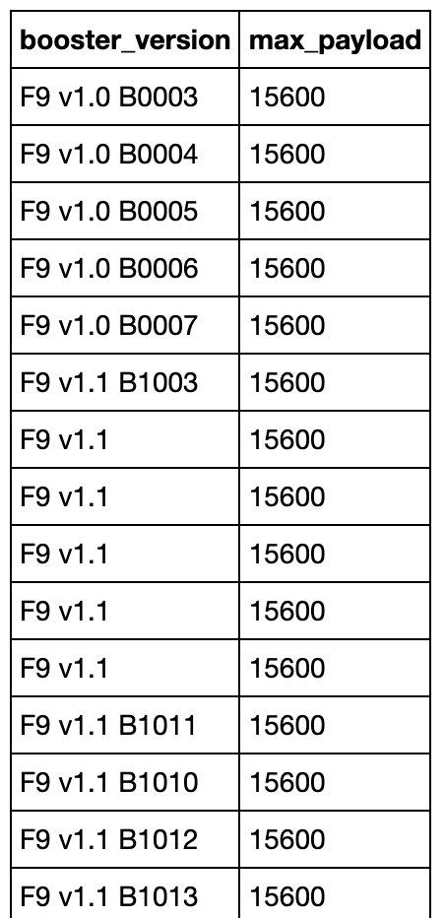
Boosters carried maximum payload
List the names of the booster which have carried the maximum payload mass
Present your query result with a short explanation here
The above query returns the names of the booster versions which have carried the maximum payload mass. With the maximum payload mass of 15,500kg, the list is quite long and exhaustive too.

Slide 33
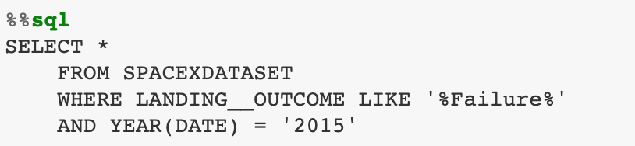
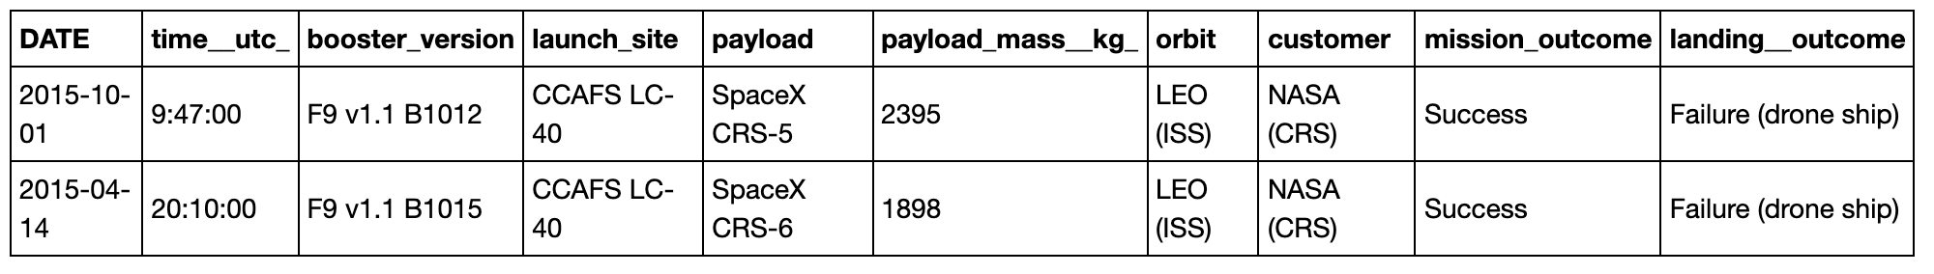
2015 launch records
List the records which will display the month names, failure landing outcomes in drone ship ,booster versions, launch site for the months in year 2015
Present your query result with a short explanation here
The search return only two rows as the output for this category.

Slide 34
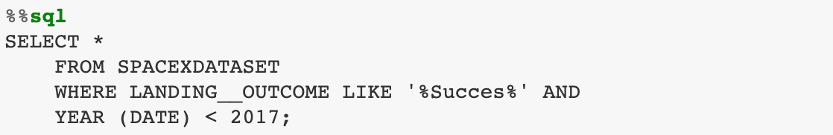
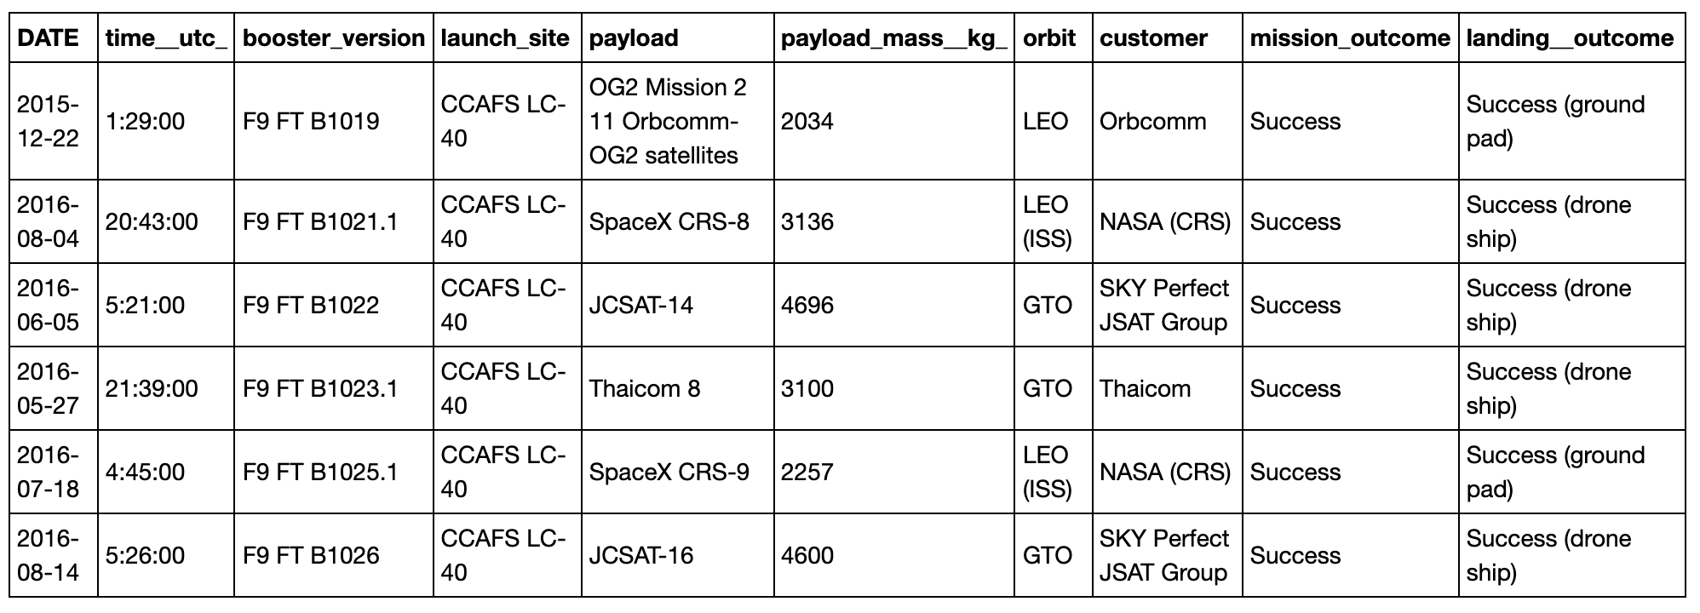
Rank success count between 2010-06-04 and 2017-03-20
Rank the count of successful landing outcomes between the date 2010-06-04 and 2017-03-20 in descending order.
The query returns the count of successful landing outcomes between 2010 and 2017

Slide 35
Interactive map with Folium

Slide 36
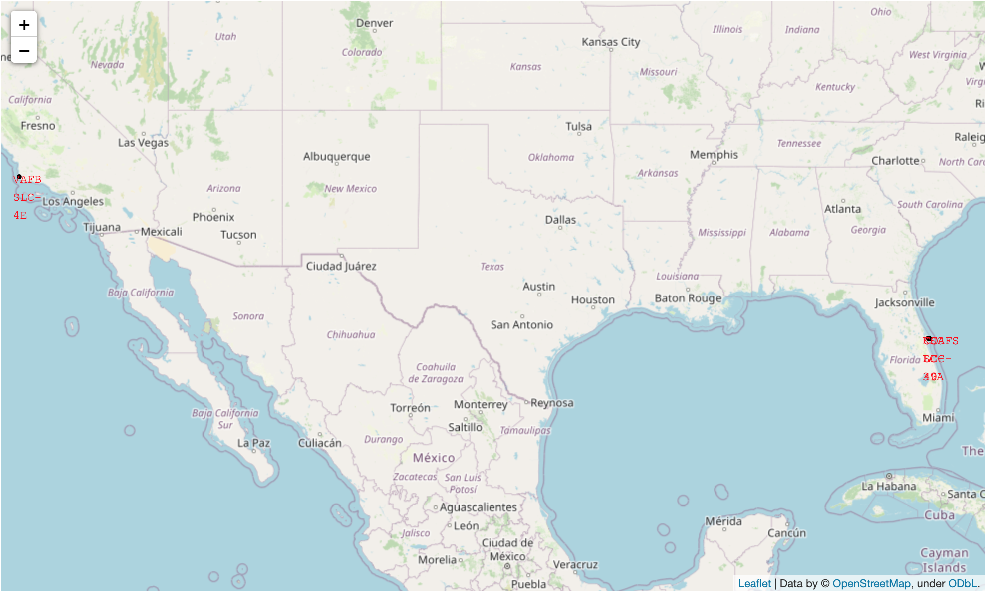
< launch sites’ location markers on a global map >
The launch site have been marked on the map.
Geographically, there are located are on the East and West coast of the US.

Slide 37
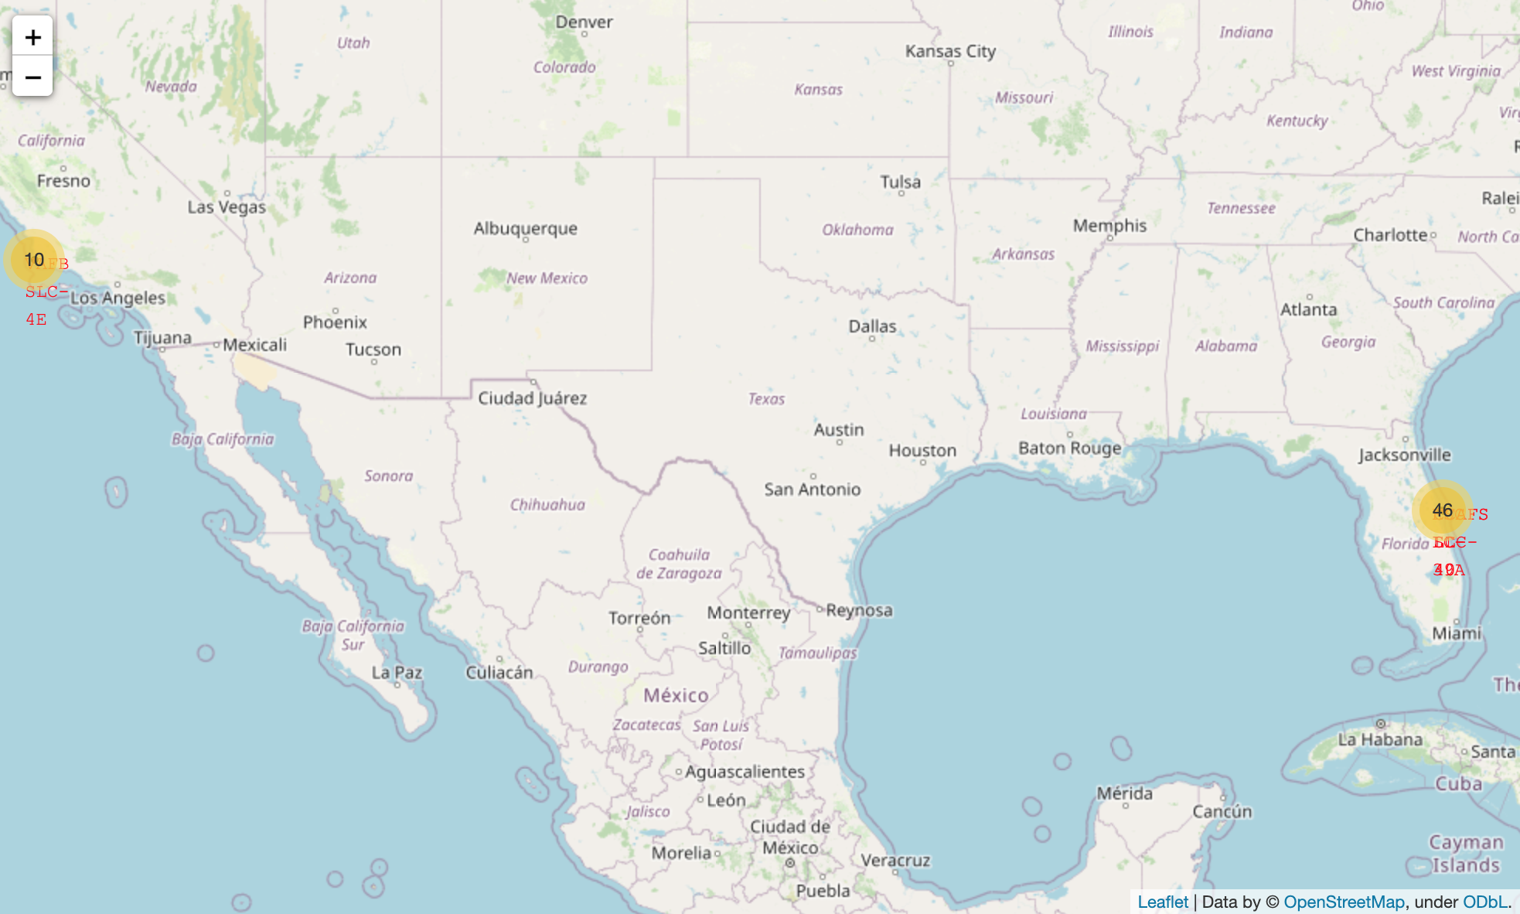
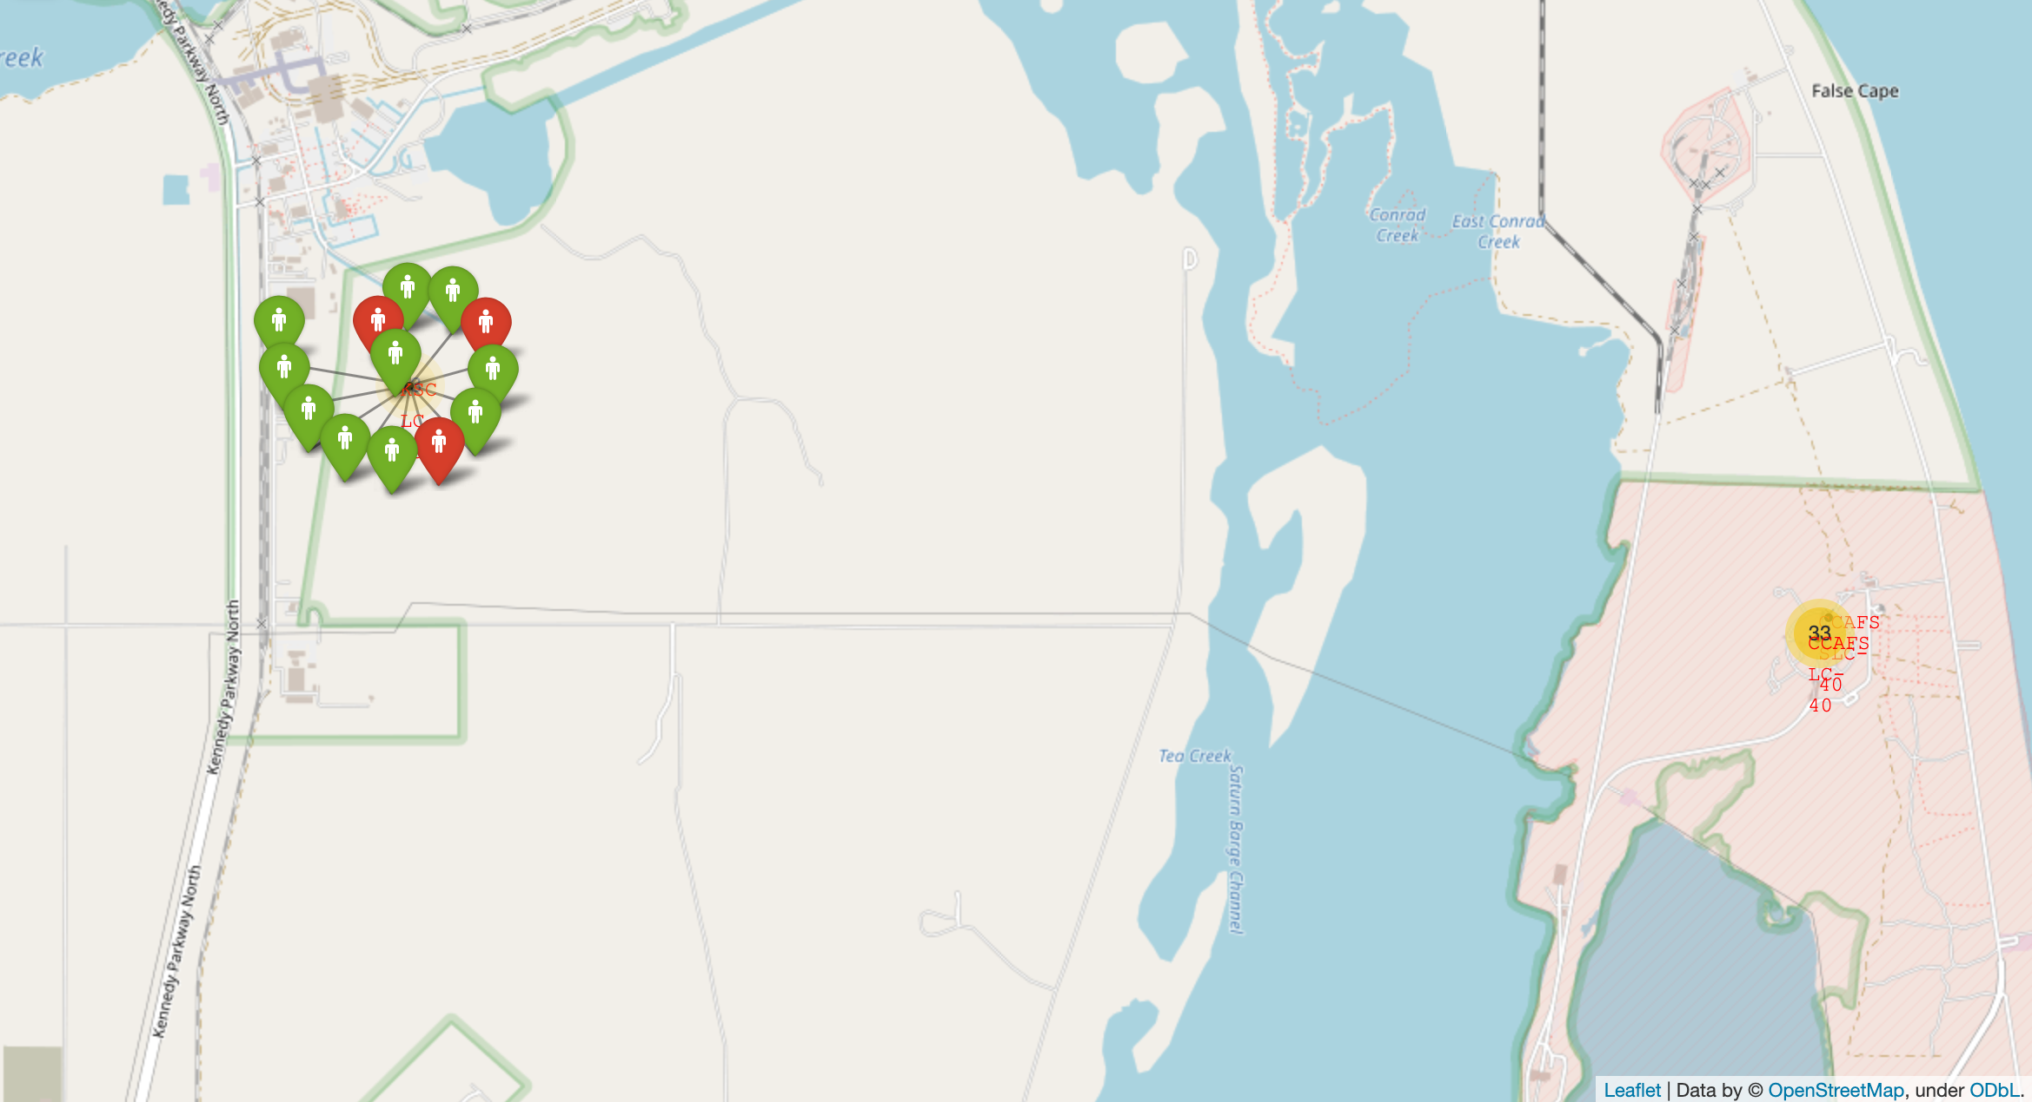
< color-labeled launch records on the map >
The map shows the location of some of the launch sites on the Eastern coast of the US.
The green points indicates successful launch and red for failed launch

Slide 38
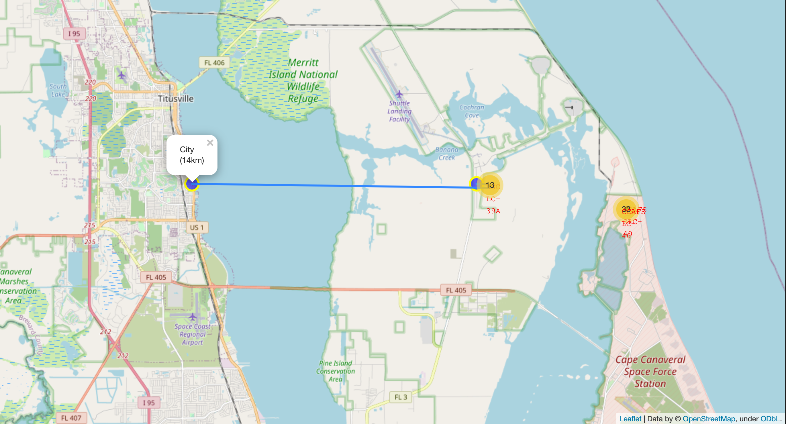
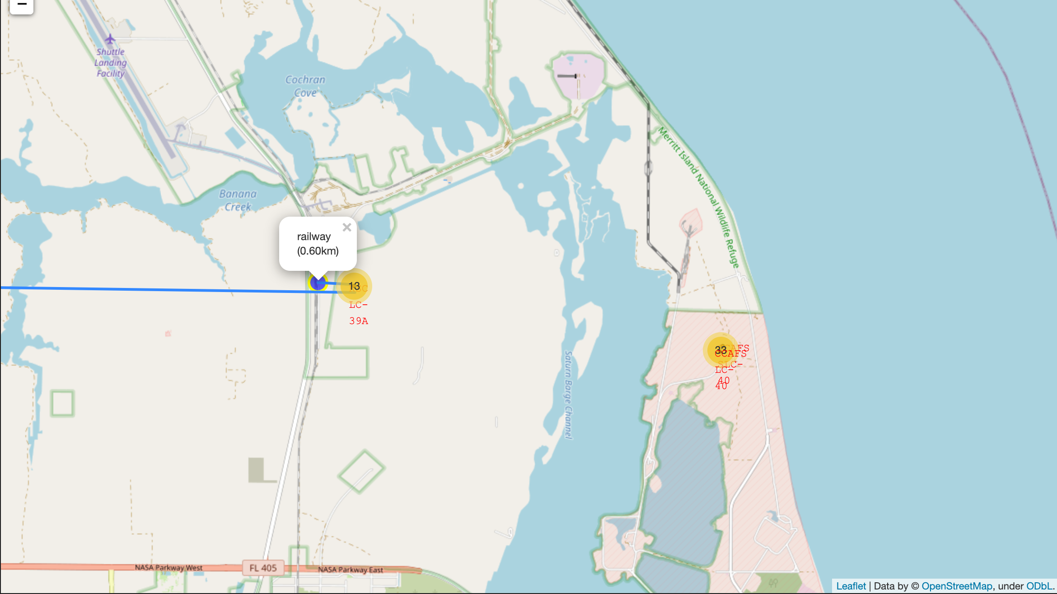
< A selected launch site to its proximities railway, coastline with distance >
The launch sites is in close proximity to a railway, about 0.6km away, but are somewhat far from the nearest city at about 14km away.
City area
Coastline

Slide 39
Build a Dashboard with Plotly Dash

Slide 40
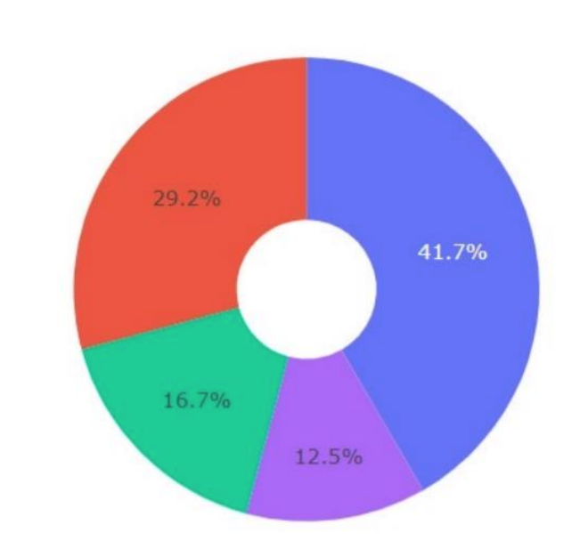
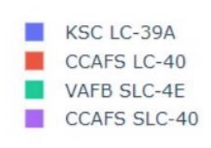
<launch success count for all sites, in a piechart>
The plot below is a screenshot explaining the important elements and findings on the Launch sites success counts
From the Piechart, we can observe that the launch site KSC LC-39A has the most success count

Slide 41
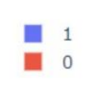
<launch site with highest launch success ratio>
The plot below is a screenshot explaining the important elements and findings on the Launch sites success counts
From the data from the previous plots, KSC LC-39A has the most success ratio of 76.9% and 23.1% failure rate.

Slide 42
< Payload vs. Launch Outcome scatter plot for all sites >
The plot above is a screenshot explaining the important of payloads and launch outcomes.
It is observed that Low weighted payloads have a higher success rate

Slide 43
Predictive analysis (Classification)

Slide 44
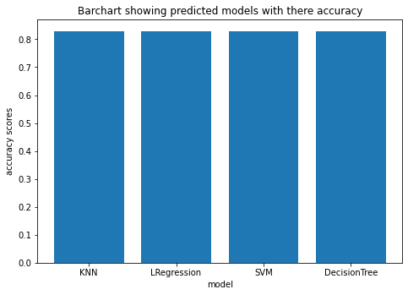
Classification Accuracy
From the chart, we can observe that:
All models: ('Logistic Regression,', 'Decision Tree', 'KNN', '&', 'SVM') provided similar results with 0.83 as the final values after applying hyper-parameter tunning.

Slide 45
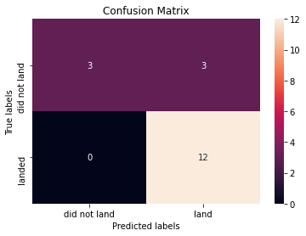
Confusion Matrix
Here’s the confusion matrix of the best performing model

Slide 46

CONCLUSION
Point1: Most of the Falcon9 rocket launching took place at the CCAFS LC-40, with over 60% success rate.
Point 2: Falcon9 rocket launches with relatively lower payload masses are observed to have high success rate
Point 3: Orbits with high success rate includes: ESL, GEO, HEO, SSO, & VLEO
Point 4: All models: ('Logistic Regression,', 'Decision Tree', 'KNN', '&', 'SVM') provided similar results with 0.83 as the final values following hyper-parameter tuning.
POINT 5: There’s been improvement in the success outcomes year on year…

